Slide 1
Network Layer: Classful IP Addressing
Covers Chapter# 18 from Text Book
Computer Communication & Networks
(CEN-223)
Fall 2022 (BSE-5A)

Slide 2
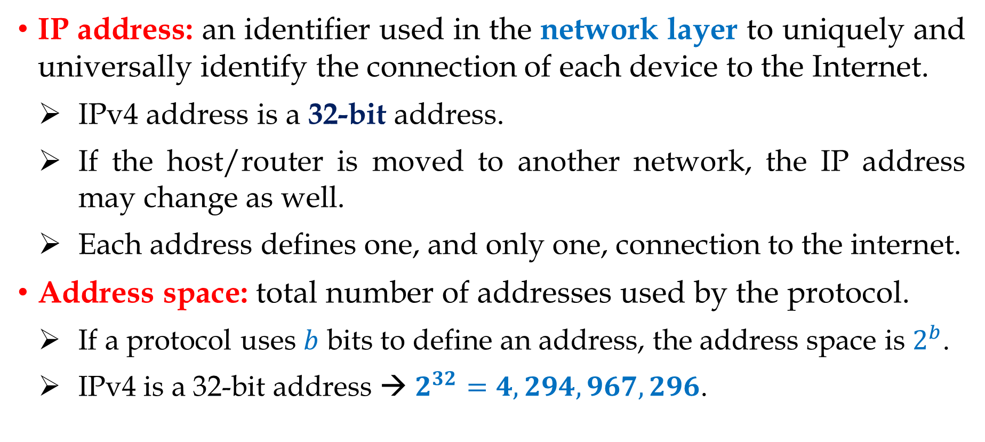
IPv4 Addresses
IP address: an identifier used in the network layer to uniquely and universally identify the connection of each device to the Internet.
IPv4 address is a 32-bit address.
If the host/router is moved to another network, the IP address may change as well.
Each address defines one, and only one, connection to the internet.
Address space: total number of addresses used by the protocol.
If a protocol uses $b$ bits to define an address, the address space is $2^{b}$.
IPv4 is a 32-bit address → $2^{32}=4,294,967,296$.

Slide 3
IPv4 Address Notations
Three notations can be used to show an IPv4 address:
Binary notation (base 2): IPv4 address is displayed as 32 bit, and divided into 4 octets (each of 8-bits).
Dotted-decimal notation (base 256): IPv4 are usually written in decimal form, with a decimal point (dot) separating the octets. Since each octet is only 8-bits, hence each number in an octet and is between 0 and 255.
Hexadecimal notation (base 16): since each hexadecimal digit is represented by 4 bits, hence the 32-bit address has 8 hexadecimal digits (often used in network programming).

Slide 4
IPv4 Address Notations (Cont.)

Slide 5
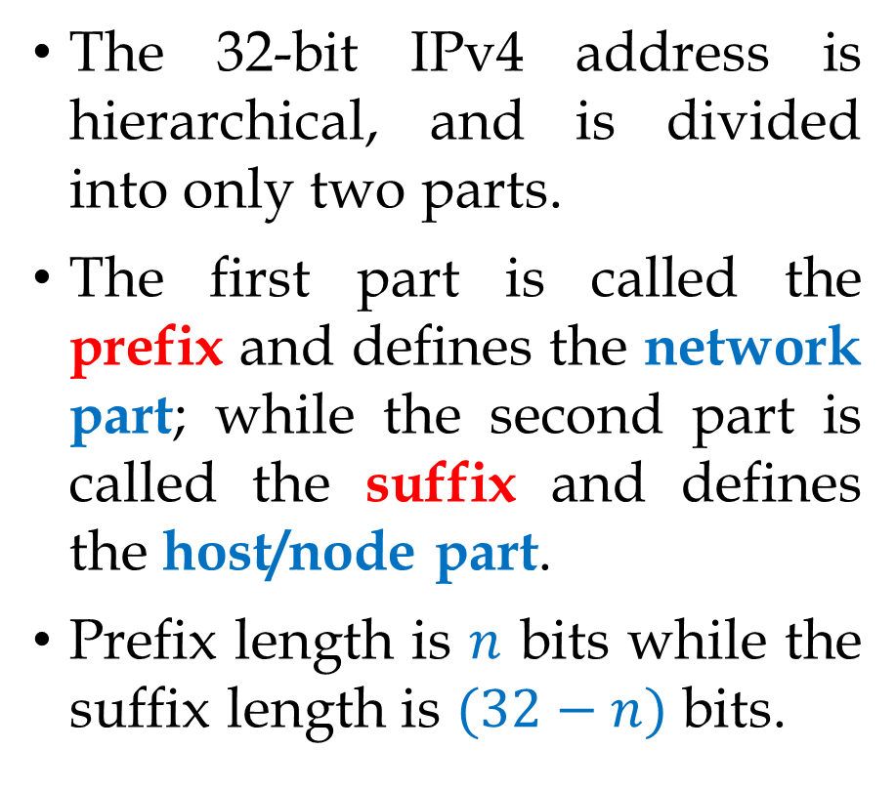
IPv4 Address Hierarchy
The 32-bit IPv4 address is hierarchical, and is divided into only two parts.
The first part is called the prefix and defines the network part; while the second part is called the suffix and defines the host/node part.
Prefix length is $n$ bits while the suffix length is $(32−n)$ bits.

Slide 6
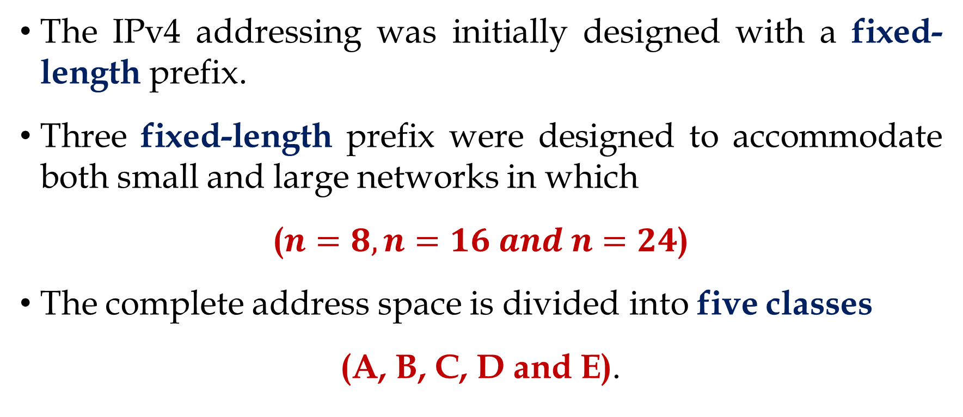
Classful Addressing
The IPv4 addressing was initially designed with a fixed-length prefix.
Three fixed-length prefix were designed to accommodate both small and large networks in which
($n=8, n=16 and n=24$)
The complete address space is divided into five classes
(A, B, C, D and E).

Slide 7
Classful Addressing (Cont.)
Class | First Octet Range
A | 0 – 127
B | 128 – 191
C | 192 – 223
D | 224 – 239
E | 240 – 255

Slide 8
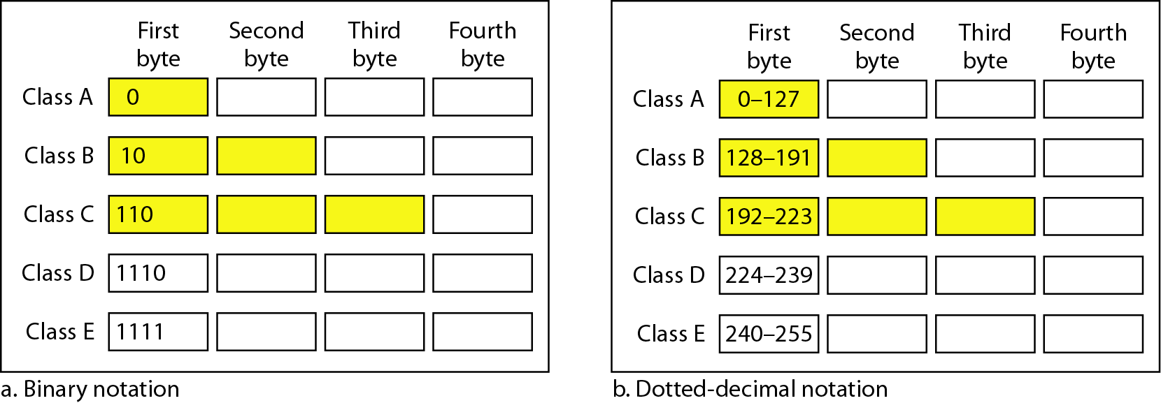
Classful Addressing (Cont.)

Slide 9
Classful Addressing (Cont.)
Network ID (Network address): identifies a single network within a larger internetwork.
All systems attached to the same network have a common network ID within their full IP address.
Host ID (Host address): identifies a single node within each network (e.g. desktop, laptop, smartphone, router, network printer, etc).

Slide 10
Classful Addressing (Cont.)
Subnet mask: a 32-bit value that defines the prefix length.
By subnet mask we divides the IP address into network address and host address.
E.g. For IP address 192.168.10.32 → The subnet mask is 255.255.255.0, i.e. First 24 bits are 1 and the rest are 0.
Default masks for classful addressing

Slide 11
Classful Addressing (Cont.)

Slide 12
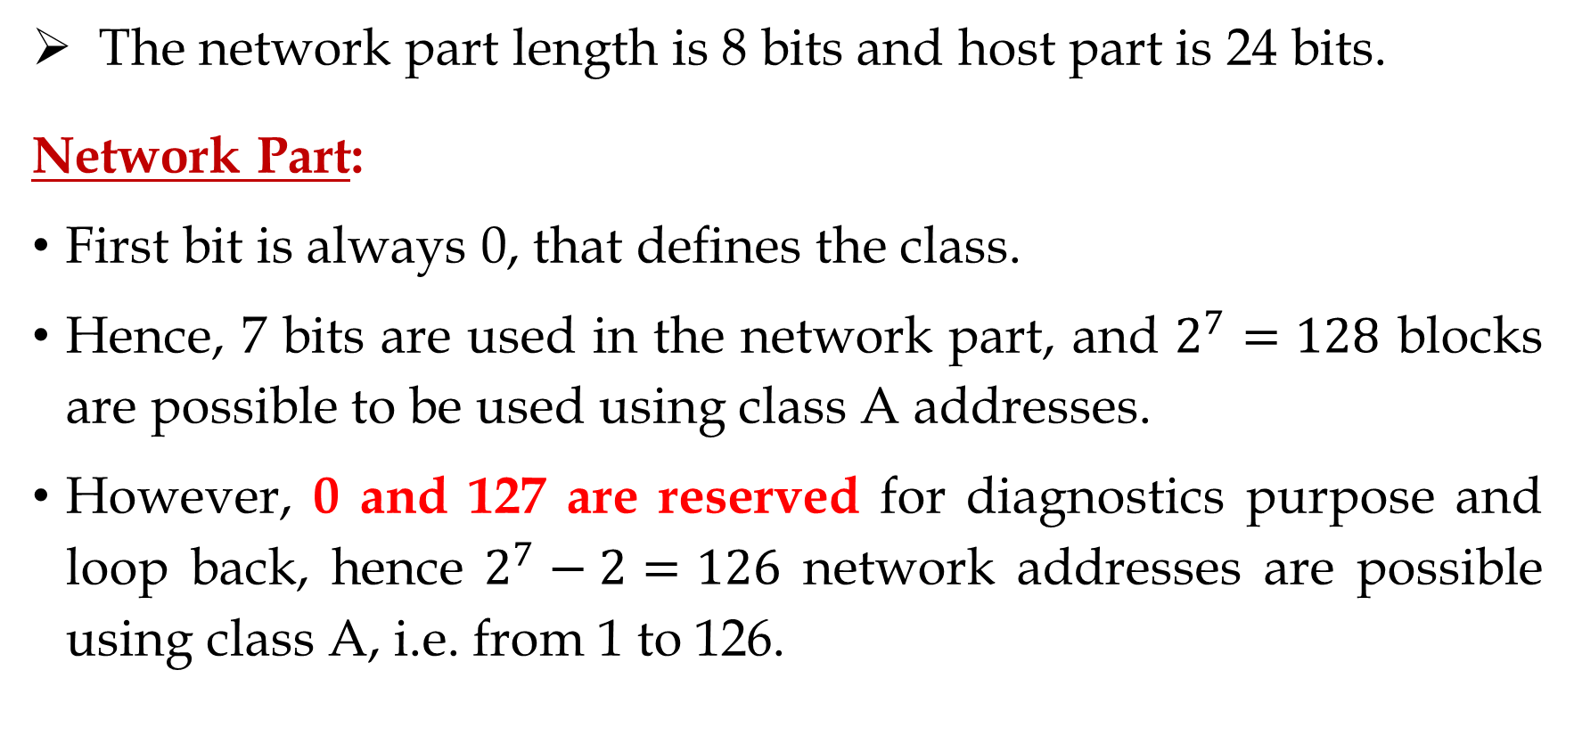
Class A Address
The network part length is 8 bits and host part is 24 bits.
Network Part:
First bit is always 0, that defines the class.
Hence, 7 bits are used in the network part, and $2^{7}=128$ blocks are possible to be used using class A addresses.
However, 0 and 127 are reserved for diagnostics purpose and loop back, hence $2^{7}−2=126$ network addresses are possible using class A, i.e. from 1 to 126.

Slide 13
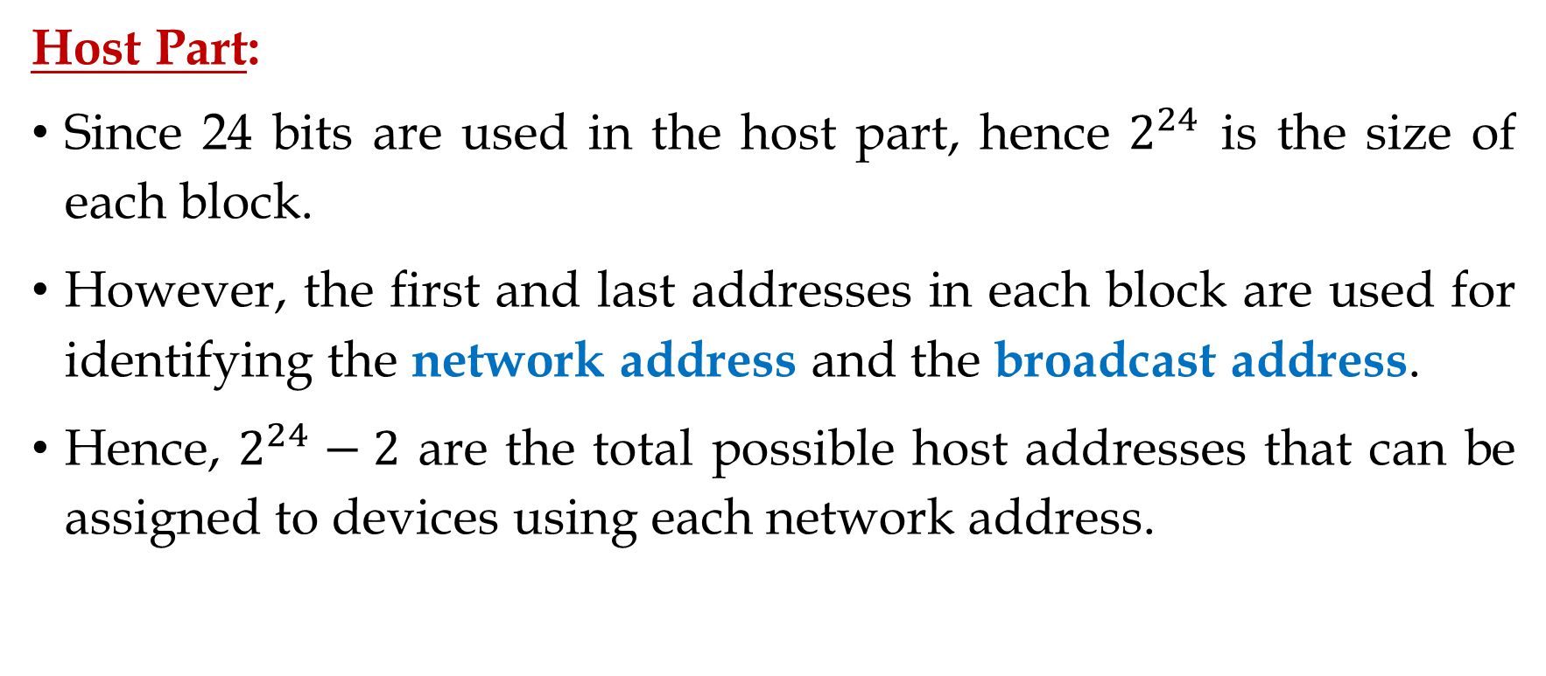
Class A Address (Cont.)
Host Part:
Since 24 bits are used in the host part, hence $2^{24}$ is the size of each block.
However, the first and last addresses in each block are used for identifying the network address and the broadcast address.
Hence, $2^{24}−2$ are the total possible host addresses that can be assigned to devices using each network address.

Slide 14
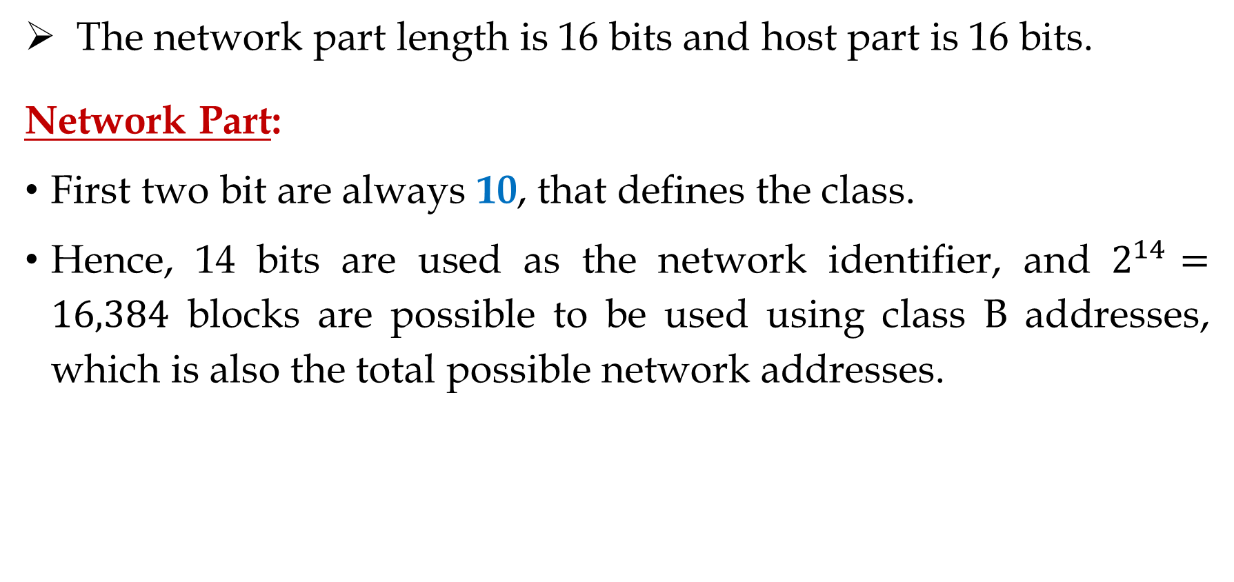
Class B Address
The network part length is 16 bits and host part is 16 bits.
Network Part:
First two bit are always 10, that defines the class.
Hence, 14 bits are used as the network identifier, and $2^{14}=16,384$ blocks are possible to be used using class B addresses, which is also the total possible network addresses.

Slide 15

Class B Address (Cont.)
Host Part:
Since 16 bits are used in the host part, hence $2^{16}$ is the size of each block.
However, the first and last addresses in each block are used for identifying the network address and the broadcast address.
Hence, $2^{16}−2$ are the total possible host addresses that can be assigned to devices using each network address.

Slide 16
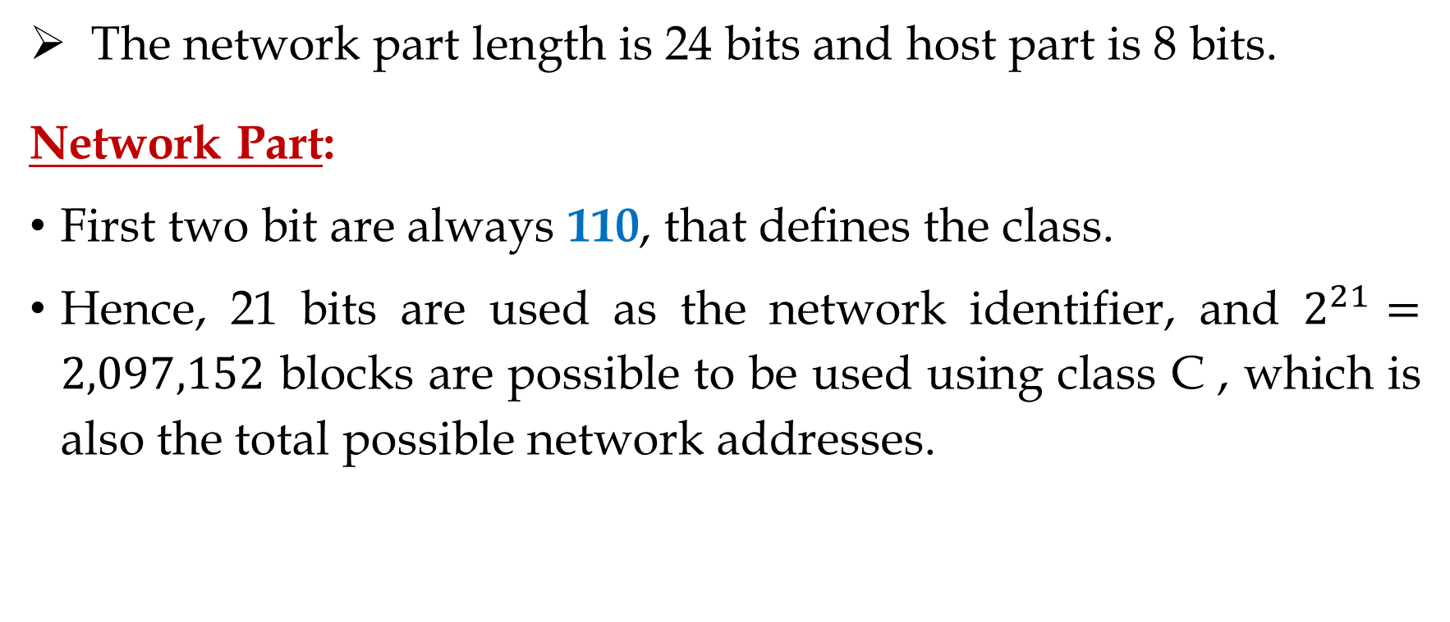
Class C Address
The network part length is 24 bits and host part is 8 bits.
Network Part:
First two bit are always 110, that defines the class.
Hence, 21 bits are used as the network identifier, and $2^{21}=2,097,152$ blocks are possible to be used using class C , which is also the total possible network addresses.

Slide 17
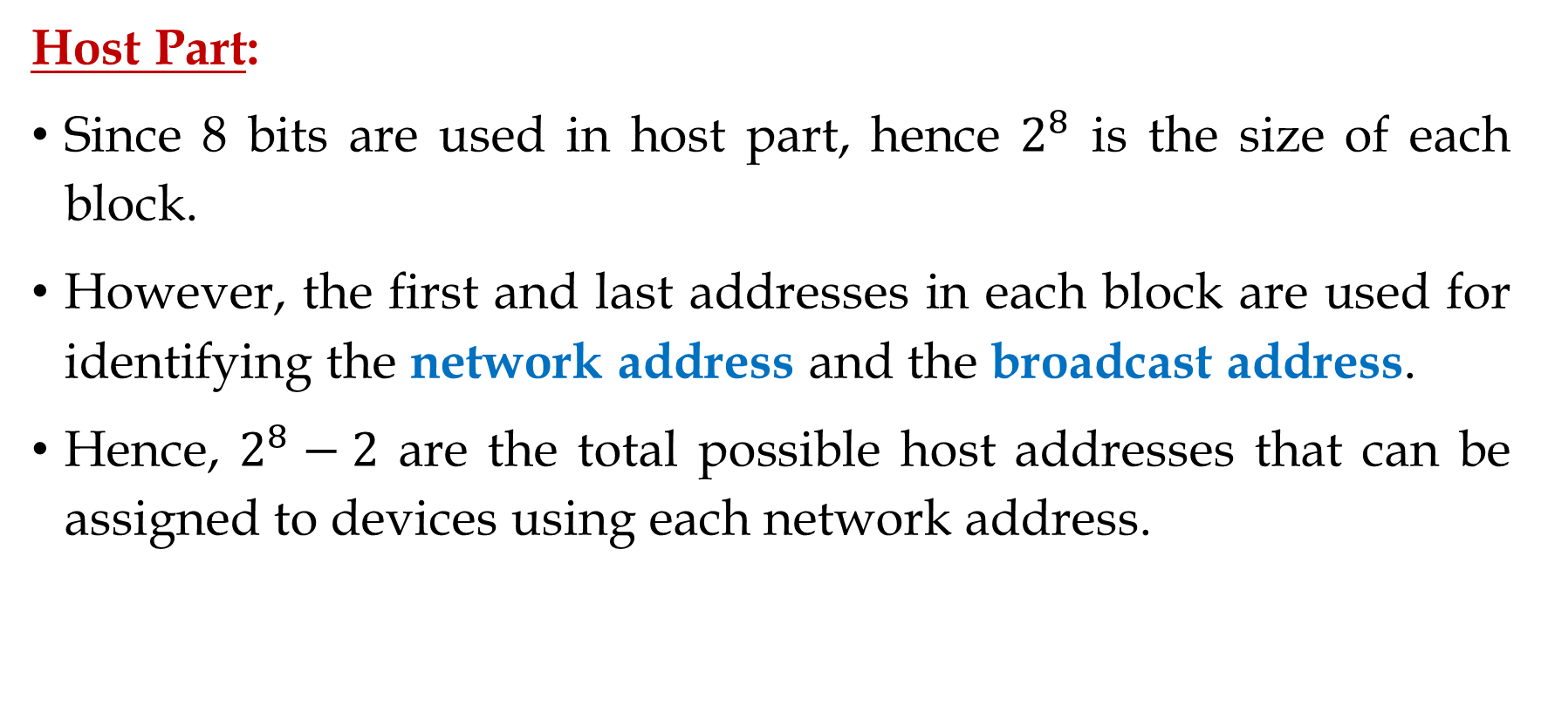
Classful Addressing (Cont.)
Host Part:
Since 8 bits are used in host part, hence $2^{8}$ is the size of each block.
However, the first and last addresses in each block are used for identifying the network address and the broadcast address.
Hence, $2^{8}−2$ are the total possible host addresses that can be assigned to devices using each network address.

Slide 18
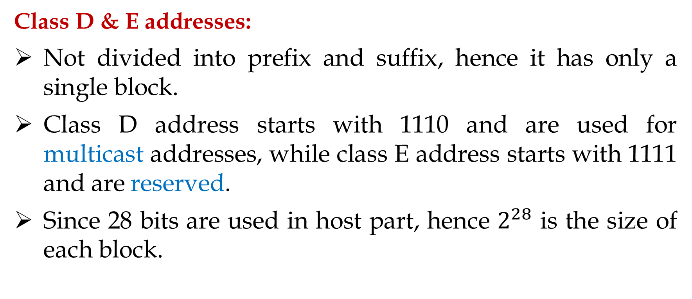
Classful Addressing (Cont.)
Class D & E addresses:
Not divided into prefix and suffix, hence it has only a single block.
Class D address starts with 1110 and are used for multicast addresses, while class E address starts with 1111 and are reserved.
Since 28 bits are used in host part, hence $2^{28}$ is the size of each block.

Slide 19
Classful Addressing (Cont.)
Example 1: Change the following IPv4 addresses from binary notation to dotted-decimal notation.
Solution: We replace each group of 8 bits with its equivalent decimal number and add dots for separation.

Slide 20
Classful Addressing (Cont.)
Example 2: Change the following IPv4 addresses from dotted-decimal notation to binary notation.
Solution: We replace each decimal number with its binary equivalent.

Slide 21
Classful Addressing (Cont.)
Example 3: Find the error, if any, in the following IPv4 addresses.
Solution:
a. There must be no leading zero (045).
b. There can be no more than four numbers.
c. Each number needs to be less than or equal to 255.
d. Mixture of binary and dotted-decimal notations is not allowed.

Slide 22
Classful Addressing (Cont.)
Example 4: Find the class of each address.
a. 00000001 00001011 00001011 11101111
b. 11000001 10000011 00011011 11111111
c. 14.23.120.8
d. 252.5.15.111
Solution:
a. The first bit is 0. This is a class A address.
b. The first 2 bits are 1; the third bit is 0. This is a class C address.
c. The first byte is 14; the class is A.
d. The first byte is 252; the class is E.

Slide 23
Network/Host IP Addresses in Classful Addressing
Class A Example: the IP addresses in sequence.
17.0.0.0 Network IP address
17.0.0.1 First host IP in the network 17.0.0.0
17.0.0.2
17.0.0.255
17.0.1.0
17.0.1.1
17.0.1.2
17.0.1.255

Slide 24
Network/Host IP Addresses in Classful Addressing (Cont.)
17.0.2.0
17.0.2.1
17.0.2.2
17.0.2.255
17.0.3.0
17.0.255.0
17.0.255.1
17.0.255.2
17.0.255.255
17.1.0.0
17.1.0.1
17.1.0.2
17.1.0.255
17.1.1.0
17.255.255.254 (Last host IP)
17.255.255.255 (Broadcast address)

Slide 25
Thank You!

